Slide 1
End-to-End Phishing Attack Response
How a SOC detects, responds & shuts down a phishing attack in real time
01
02
03
Detection
Enrichment
Containment
Email gateway flags a suspicious email
SOAR automatically enriches alert with threat context
SOAR playbook triggers automatically
04
05
06
Investigation
Remediation
Documentation
Analyst uses forensic tools
Actions taken to clean and secure
Logs timeline, artifacts & audit trail
07
Reporting
Dashboard insights & lessons learned

Slide 2
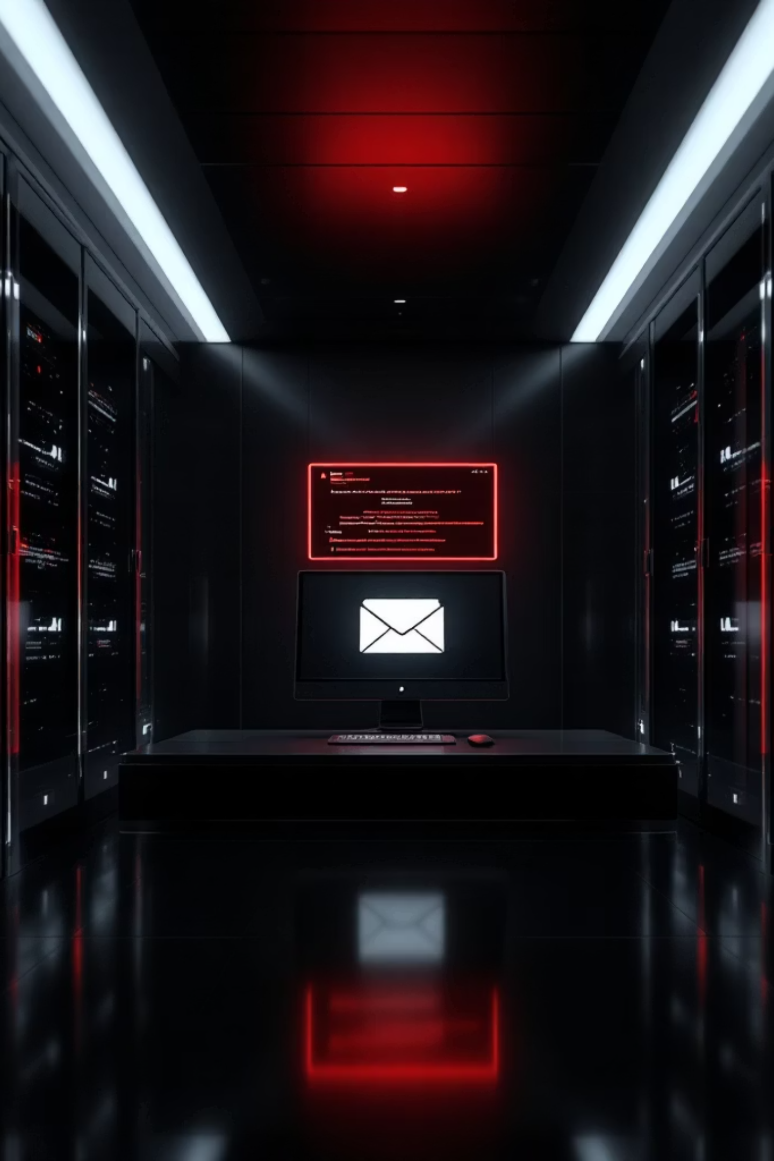

STEP 1
Detection
📧 Email Gateway
Email gateway flags a suspicious email
🔗 Malicious URL
Malicious URL detected
📡 SIEM Alert
Alert sent to SIEM (e.g., Splunk)
🚨 SOC Analyst
SOC Analyst receives the alert!

Slide 3


STEP 2
Enrichment
SOAR automatically enriches the alert with full threat context:
Extracts the malicious URL
Checks VirusTotal → MALICIOUS
SOAR pulls the URL from the flagged email for analysis
Automated lookup confirms the URL is malicious
Queries MISP → Linked to APT29
Enriches alert with threat context
Threat intelligence platform links the indicator to known threat actor APT29
Full context is appended to the alert for analyst review

Slide 4

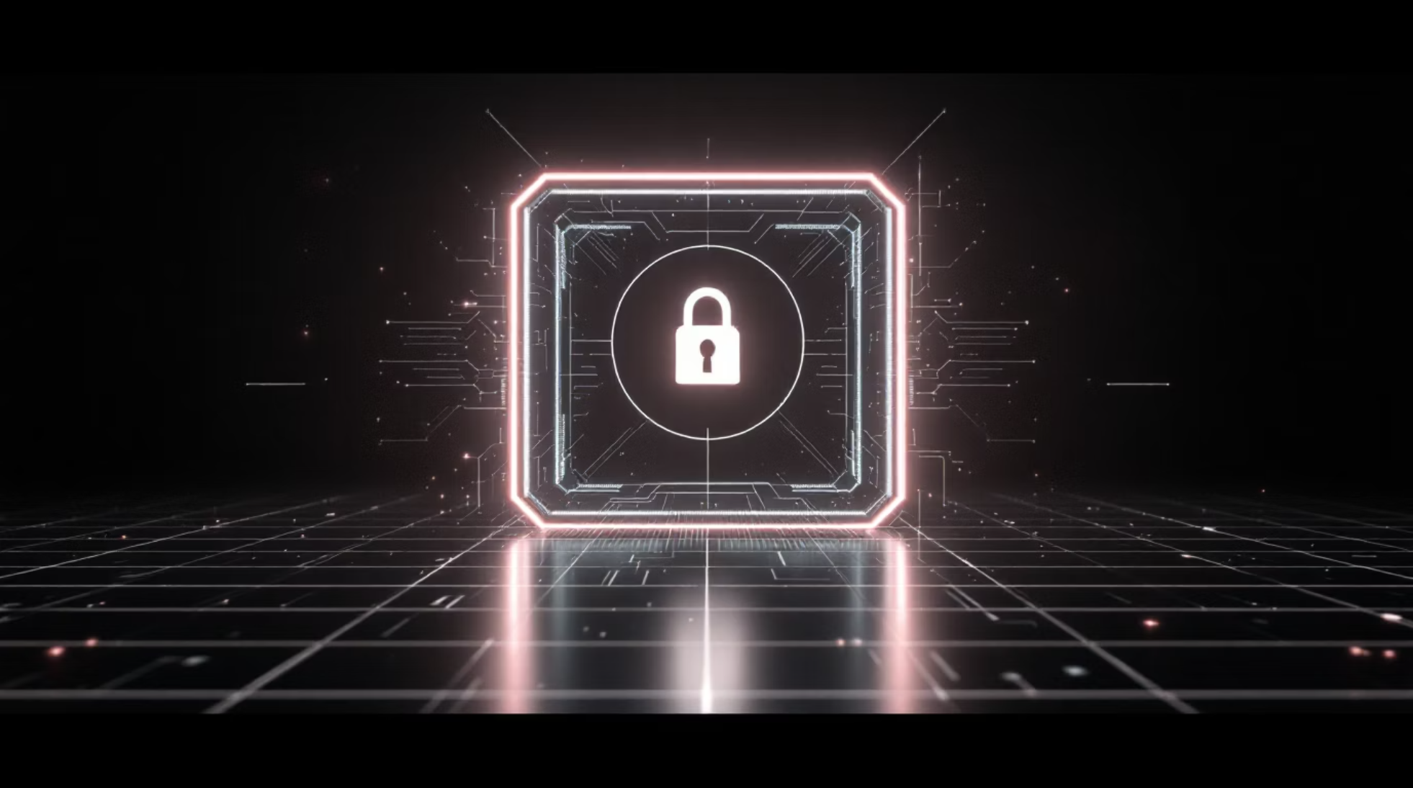

STEP 3
Containment
SOAR Playbook Triggers Automatically
Blocks URL in firewall & proxy
Isolates user's device via EDR
Removes phishing email from all inboxes
All done in under 90 seconds!

Slide 5


STEP 4
Investigation
Analyst uses forensic tools to determine the full scope of the threat:
Volatility
Wireshark
Autopsy
Checks RAM for malware — memory forensics to detect in-memory threats
Checks for data exfiltration — network packet analysis to detect outbound data leaks
Reviews disk for persistence — disk forensics to find any installed backdoors or artifacts
Result: No malware executed. Threat neutralized!

Slide 6






STEP 5
Remediation
Actions taken to fully restore security posture:
Password Reset
Device Cleaned
Firewall Updated
User's password reset
Device scanned & cleaned
Firewall rules updated
Vulnerability Patched
User Notified
Vulnerability patched
User notified & educated

Slide 7


STEP 6
STEP 7
Documentation
Reporting & Lessons Learned
TheHive / ServiceNow logs:
Kibana Dashboard shows:
Timeline of the attack
Affected users & systems
Phishing attacks up 20% this week
Top affected dept: Finance & HR
Actions taken by analysts
Artifacts collected
Most common malware: Emotet
Ensures accountability & audit trail
🎯 Action: Deploy security awareness training!

Slide 8



A Strong SOC Uses:
SIEM
SOAR
EDR
Detect
Automate
Contain
Forensics
Dashboard
Investigate
Report
💬 Which tool does your SOC rely on most? Drop it in the comments!
📱 Platform
🎨 Design
🛠️ Tools
⏰ Best Time to Post
LinkedIn or Instagram works best for carousels
Use a consistent color theme (e.g., dark blue + white text)
Canva, Adobe Express, or PowerPoint for design
Tuesday–Thursday, 9AM–11AM for maximum reach

